Slide 1


SAP UI5 & FIORI with OData TRAINING
Anubhav Oberoy & Shekhar Vedi
Day – 5

Slide 2

Agenda – Day 5
Resource model in UI5
Multi-Language Support of the App
Formatter in UI5

Slide 3
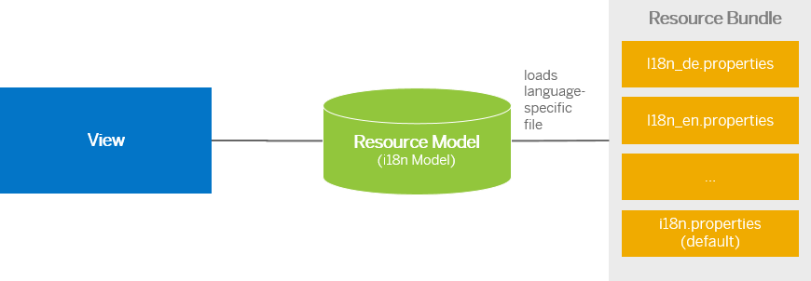
Resource Model
We build software for international audience, we cannot just hardcode every screen element in English, if it requires multi-lingual support, we need to add resource model.
i18n → Internationalization
Create resource bundle which includes label field
The name of the file must be i18n.properties for default labels
And i18n_langcode.properties for different languages
Set The model
For more information about i18n you check the link
https://openui5.hana.ondemand.com/1.34.9/docs/guide/831039835e7c4da3a8a0b49567573afe.html
We can change the language of the app by adding ?sap-language=language_code at the end of the URL of the app. Example for Hindi we will write ?sap-language=hi

Slide 4

Exercise
In this exercise we will see how the language of an app is changed using the i18n file.
We have to create a folder ‘i18n’ in webapps folder and in the folder, we have to add files named ‘i18n.properties’ and one another file named according to the language we want. For example:- for Hindi language the file is named as ‘i18n_hi.properties’.
Along with that we will add a delete button on top of the table to delete the record of an employee from the model.
Exercise Code:-
MyXML.view.xml
MyXML.controller.js
i18n.properties
i18n_hi.properties

Slide 5
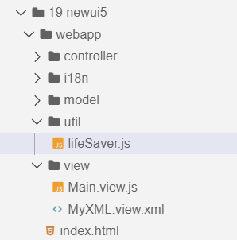
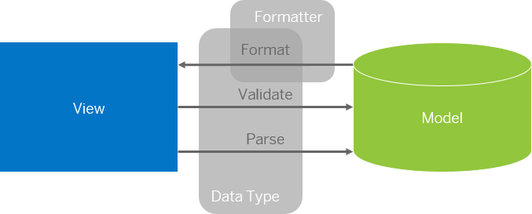
Formatter in SAP UI5
Formatters are used to define the formatting of data on the UI while data types work in both directions: they format the data on the UI and parse and validate user input that is entered.
Formatter is a function, This function gets called JUST Before the binding takes place with the view.
Formatter file is placed in a folder in webapp folder and the file can be named anything with the .js extension.
Formatter

Slide 6

Exercise
In this exercise we are going to currency code in the table.
We will convert the currency code into it corresponding currency symbol.
We will achieve this by using a formatter function.
Exercise Code:-
MyXML.view.xml
MyXML.controller.js
lifeSaver.js

Slide 7

End of Day 5

Slide 8

Questions

Slide 9

Anubhav Oberoy

Slide 10


We’re committed to empower you to be
Most Desirable Resource
through powerful training solutions.
We build the workforce of the future.
250+
Corporate Clients
30,000+
Learners Trained
25000+
Learners Placed
FREE WEBINARS
Sign up for free webinars with industry experts every fortnight!
Enroll Now!
Contact us today!
https://anubhavtrainings.com/

Slide 11




More from AnubhavTrainings.com

Slide 12
Title
Content

